Slide 1
RADON LESSON

Slide 2
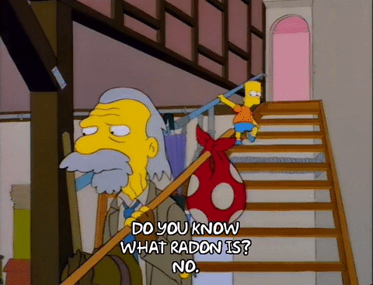
YOU WILL LEARN
What is Radon?
How Radon is Formed
Types of Ionizing Radiation
How Radon Affects Your Health
How Radon Damages Cells
How Radon Gets into Homes
What Causes Higher Radon Levels in Homes
How to Test for Radon
How Radon is Measured
What to do if Your Home has High Radon Levels

Slide 3
RADON & RADIATION
PART 1A

Slide 4
WHAT IS RADON?
An odorless, invisible, tasteless, radioactive gas found in nature
Radioactive means that it emits radiation when the atoms spontaneously change into different atoms
Builds up in many homes and buildings and can be a health hazard for you and your family

Slide 5
HOW RADON IS FORMED
URANIUM:
Is a radioactive element that was present when earth formed – and still exists today!
When uranium breaks down (decays) it forms radium.
When radium breaks down (decays) it forms radon.

Slide 6
PERIODIC TABLE OF ELEMENTS
Radon
Radium
Uranium

Slide 7
TYPES OF IONIZING RADIATION
Radiation is energy that moves from one place to another by waves or atomic particles.
Ionizing Radiation is a type of high-energy radiation that has enough energy to remove an electron (negative particle) from an atom causing it to become ionized.
We will focus on 3 types of ionizing radiation:
Alpha
Beta
Gamma

Slide 8
TYPES OF IONIZING RADIATION
Type | Characteristic
Alpha (α) | Particle is relatively large Composed of 2 neutrons and 2 protons Has a mass of four atomic mass units Has an electrical charge of +2 Not very penetrating Extremely hazardous when particles enter the body
Beta (β) | Particle is very small Is an electron Has a charge of -1 Can penetrate body tissue externally
Gamma (γ) | Ray has no mass and no charge Can easily penetrate body tissues from an external source Electromagnetic radiation

Slide 9
TYPES OF IONIZING RADIATION ACTIVITY
Observations |  |  |  |  | Inferences
Ball Type | Trial #1 | Trial #2 | Trial #3 | Avg. | Radiation Type
Tennis
Sm. plastic
Styro- foam
DESP 3R’s: teacher resource (no date). Unit 3: What is Radon? [Word document]

Slide 10
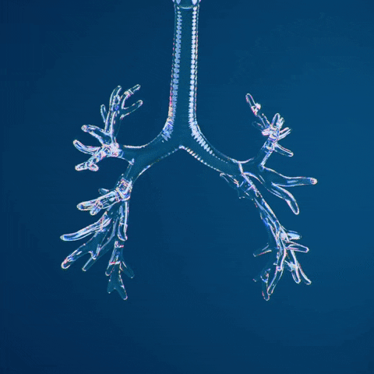
RADON & DNA DAMAGE
PART 1B

Slide 11
How Radon Affects Your Health
Radon is the leading environmental cause of cancer mortality.
Radon kills about 21,000 people in the U.S. every year.
Radon is the leading cause of lung cancer in non-smokers.
Smokers exposed to radon double their risk of getting lung cancer.

Slide 12
HOW RADON AFFECTS YOUR HEALTH
When we breathe, radon decay products may become trapped in our lungs.
Radon can damage lung tissue cells and increase the risk of lung cancer.
Our risk of developing lung cancer from breathing radon depends on two factors:
The amount of radon in the air that we breathe.
How long we breathe air containing radon decay products.

Slide 13
HOW RADON DAMAGES CELLS
Radon gas can be inhaled and exhaled
The half-life of radon is 3.8 days
Half life is the time required for half of the atoms to decay
Radon decay products cling to dust particles in the air which can be inhaled into your lungs and remain stuck to your lung tissue
As radon breaks down it emits radiation
Ionizing radiation strike cells causing physical and/or chemical damage to DNA

Slide 14
RADON DECAY PRODUCT IN LUNGS

Slide 15
HOW RADON DAMAGES CELLS
The ionizing radiation emitted by radon causes damage that results in:
Cell death
Cell self-repair to its pre-damaged state
Cell self-misrepair

Slide 16
HOW RADON DAMAGES CELLS
Cells that self-misrepair after being damaged by ionizing radiation will not necessarily become cancerous
It takes multiple genetic injuries over many cell generations for cancer to occur

Slide 17
RADON IN THE HOME PART 2

Slide 18
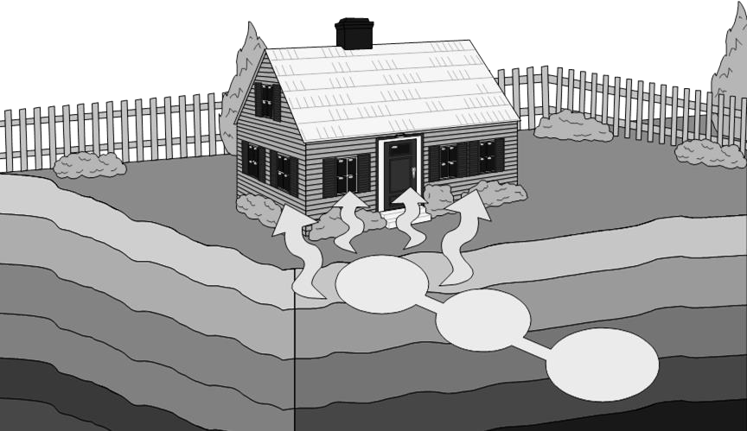
HOW RADON GETS INTO HOMES
Radon
Radium
Uranium

Slide 19
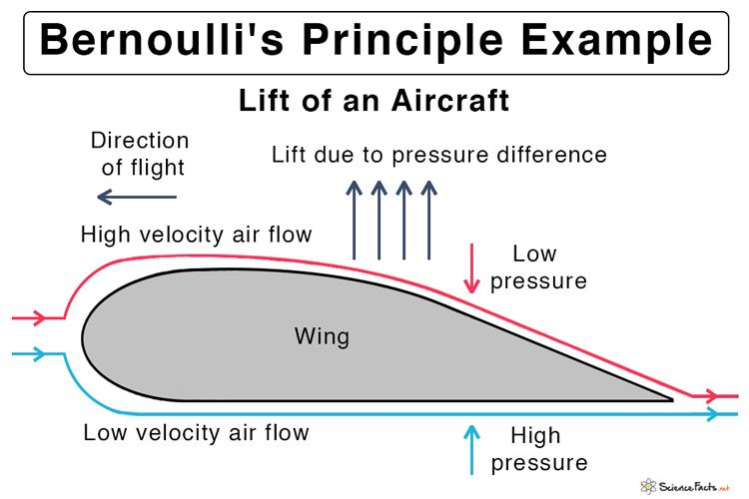
HOW RADON GETS INTO HOMES
Fast airflow results in a low pressure area.
Slow airflow results in a high pressure area.
Higher pressure under an airfoil causes lift.
Image source: https://www.sciencefacts.net/bernoullis-principle-and-equation.html

Slide 20
HOW RADON GETS INTO HOMES
First, it travels in small spaces in soil and rock under our homes
Then, it gets drawn into a home through dirt floors, crawl spaces, cracks and pores in floors and walls

Slide 21
Pressure differences are created around a house
WHAT CAUSES HIGHER RADON LEVELS IN HOMES
Radon moves from high pressure to low pressure

Slide 22
WHAT CAUSES HIGHER RADON LEVELS IN HOMES
Weather Factors:
High Winds
Rain
Warmer indoor temperatures than outside

Slide 23
WHAT CAUSES HIGHER RADON LEVELS IN HOMES
Radon moves from high pressure area to a low pressure area

Slide 24
WHAT CAUSES HIGHER RADON LEVELS IN HOMES
Rain fills the spaces and “caps” the radon from escaping the exposed soil, but radon will move to the dry spaces underneath the house.

Slide 25
Radon moves from high pressure area to a low pressure area
WHAT CAUSES HIGHER RADON LEVELS IN HOMES
Heating systems raise indoor air temperatures.

Slide 26
WHAT CAUSES HIGHER RADON LEVELS IN HOMES
Building Design Factors:
Air flow through vents and chimney
Activities Within Building:
Central forced air systems
Combustion appliances
Exhaust fans
Result in lower pressure inside

Slide 27
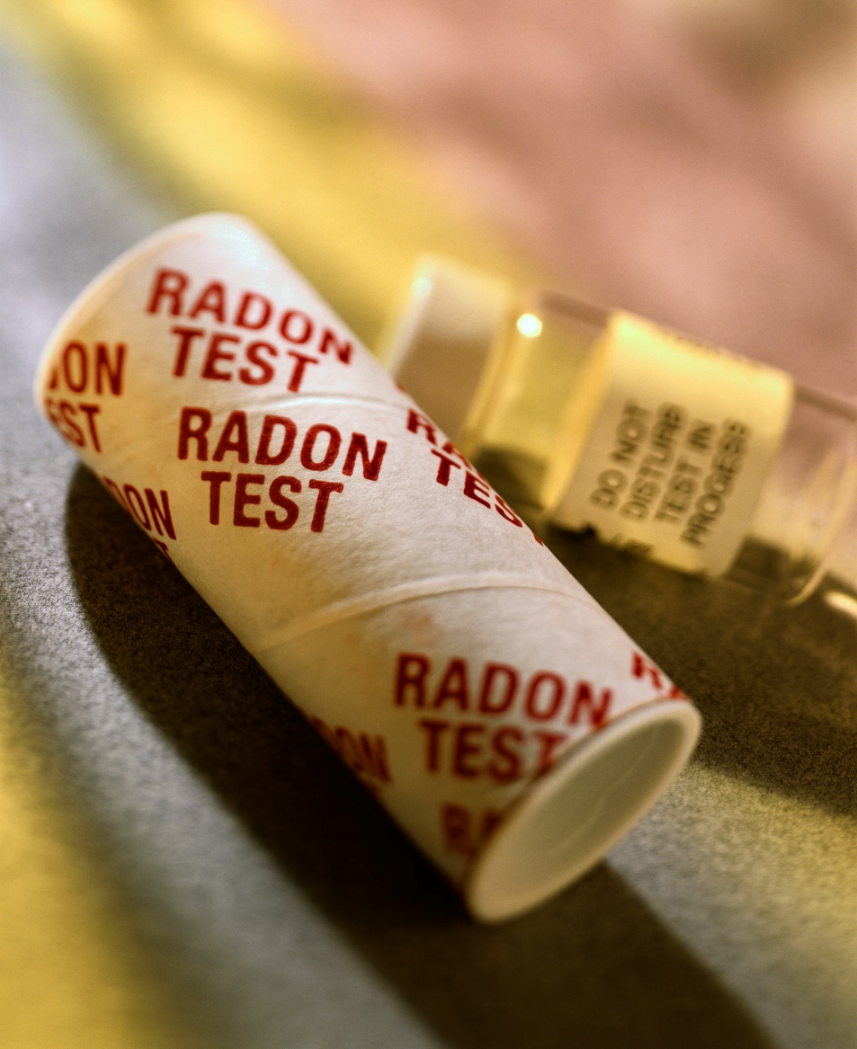
RADON TESTING
PART 3

Slide 28
HOW TO TEST FOR RADON
Charcoal Radon
Detection Devices
Short-term tests
Low cost
Easy to use
Found in most hardware stores

Slide 29
HOW TO TEST FOR RADON
Continuous Radon Monitor
Provides a better year round average of radon levels
91 days -1 year

Slide 30
HOW RADON IS MEASURED
Picocuries per liter of air (pCi/L)
EPA action level is 4.0 pCi/L or more
No level of radon is safe

Slide 31
WHAT TO DO IF YOUR HOME HAS HIGH RADON LEVELS
Not all homes or buildings have the same radon level
One home may have a low level while the home next door may have a high level

Slide 32
Testing Is The Only Way To Know
100 pCi/L
1,25 pCi/L
25 pCi/L
???

Slide 33
DON’T PANIC…
Even very high radon levels can be reduced!

Slide 34
WHAT TO DO IF YOUR HOME HAS HIGH RADON LEVELS
A “radon mitigator” is trained to lower radon levels in homes and buildings
A radon mitigation system may include:
Plastic pipe extending from basement to above the roof
Fan to suck the radon from the ground, into the pipe, and out into the air above the roof
Colorado Department of Public Health: infographic (2018). Is Your Home Safe from Radon. [PDF]

Slide 35
“The Only Way To Know” Home Radon Test
Test Kit Serial # | Prediction (Above, at or below 4pCi/L action level , and why) | Environmental Observations (external & internal variables over duration of test) | Actual Test Results (pCi/L) | Inferences (Variables that may impact reliability of test)

Slide 36
THIS PRESENTATION WAS ADAPTED FROM THE FOLLOWING RESOURCES
Connecticut Department of Public Health, Mrs. Sullivan: radon lesson (no date). Radon Lesson. [PowerPoint presentation]
DESP 3R’s: teacher resource (no date). Unit 3: What is Radon? [Word document]
EPA: radon overview (no date). Education Outreach packet. [powerpoint presentation]
Utah Department of Environmental Quality, Eleanor Divver: radiology lesson (no date). Radiological Basics. [PowerPoint presentation]

Slide 37
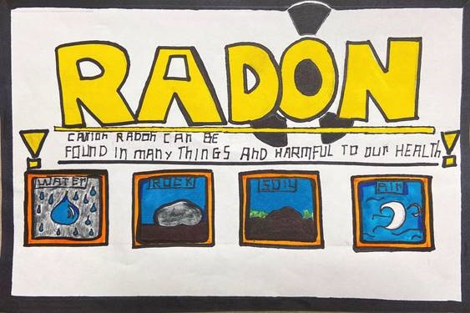
RADON POSTER CONTEST PART 4
2021 NH Radon Poster Contest Winner

Slide 38
POSSIBLE POSTER TOPICS:
Choose ONE topic to focus on from the list below …
What is radon?
Where does radon come from?
How does radon get into our homes?
Radon can cause lung cancer.
Test your home for radon.

Slide 39
ARTWORK REQUIREMENTS
No student names on front
Include a title and topic on the front
Use paper provided and fill out the Artwork Submission Form
Create with markers, crayons, paint, collage, pencil, photographs, or computer graphics
Do not use copyrighted characters, logos, or brand names
Message should be large, readable, and easily reproduced
One-inch (1”) margin

Slide 40
PRIZES
1st Place
$100 prize for grades 5-6
$100 prize for grades 7-8
$100 prize for each winning classroom
2nd Place
$75 prize for grades 5-6
$75 prize for grades 7-8
$100 prize for each winning classroom
3rd Place
$50 prize for grades 5-6
$50 prize for grades 7-8
$100 prize for each winning classroom

